Slide 1
Mercury cell In the mercury-cell process, also known as the Castner—Kellner process, a saturated brine solution floats on top of a thin layer of mercury. The mercury is the cathode, where sodium is produced and forms a sodium-mercury amalgam with the mercury. The amalgam is continuously drawn out of the cell and reacted with water which decomposes the amalgam into sodium hydroxide, hydrogen and mercury. The mercury is recycled into the electrolytic cell. Chlorine is produced at the anode and bubbles out of the cell. Mercury cells are being phased out due to concerns about mercury poisoning from mercury cell pollution such as occurred in Canada (see Ontario Minamata disease) and Japan (see Minamata disease).

Slide 2
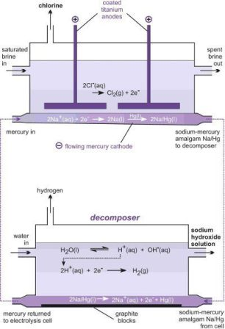
Brine Cell:
2Cl = Cl2 + e
Na + e = Na
Na + Hg = Na/Hg
Soda Cell: 2 Na/Hg + 2 H2O = 2NaOH + H2 + 2Hg

Slide 3
In the Mercury Cell Process saturated brine voyages down a steel trough roughly 15 meters in length and one meter wide between a streaming film of mercury (the cathode) and titanium plates (the anodes). Direct current is connected between the anode and cathode. Chlorine freed at the anodes gathers above the brine and is begun as a hot, wet and corrosive gas. Sodium ions are released at the surface of the streaming mercury cathode, forming an amalgam of low concentration with the mercury, which streams out of the cell without reacting with the water or chlorine. The mercury cell thus has two products (i) Hot, wet chlorine (ii) Sodium amalgam The soda cell or decomposer is a cylindrical steel trough loaded with graphite balls or graphite electrodes. The sodium amalgam is passed, along with pure water, into the decomposer, where it reacts to transform Sodium hydroxide as a controlled 50 percent aqueous solution and hydrogen gas, liberating fee mercury, which is reused again to the electrolytic cell. The graphite provides a surface that expedites this reaction.

Slide 4
Loewig’s process
Loewig’s process for caustic soda preparation depends on the formation of sodium ferrate (Na2Fe2O4), which is then decomposed with water. The soda liquors are mixed with ferric oxide, and the mass evaporated to dryness and calcined at a bright red heat, usually in a revolving furnace. By the calcination, a reaction between the sodium carbonate and the iron oxide is brought about, carbon dioxide escaping and sodium ferrate remaining in the furnace. The mass is washed with cold water until all soluble matter is removed; then water at 900 C is run over the sodium ferrate, by which it is decomposed, caustic soda formed, and iron oxide regenerated; the last is returned to the calcining process. The ferric oxide used is a natural iron ore, very clean and free from silica or other impurities; that made by calcining a precipitated ferric hydroxide is not well adapted to the process, as it gives a product difficult to lixiviate.

Slide 5
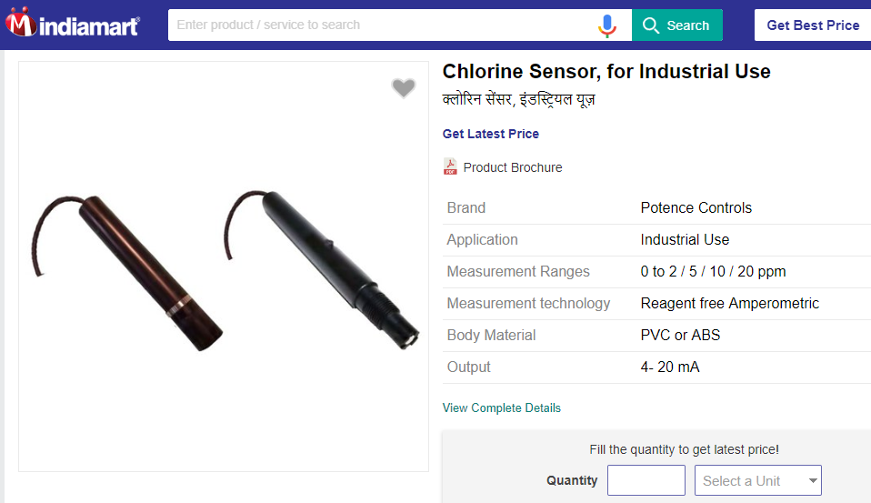
Sensors for chlorine

Slide 6
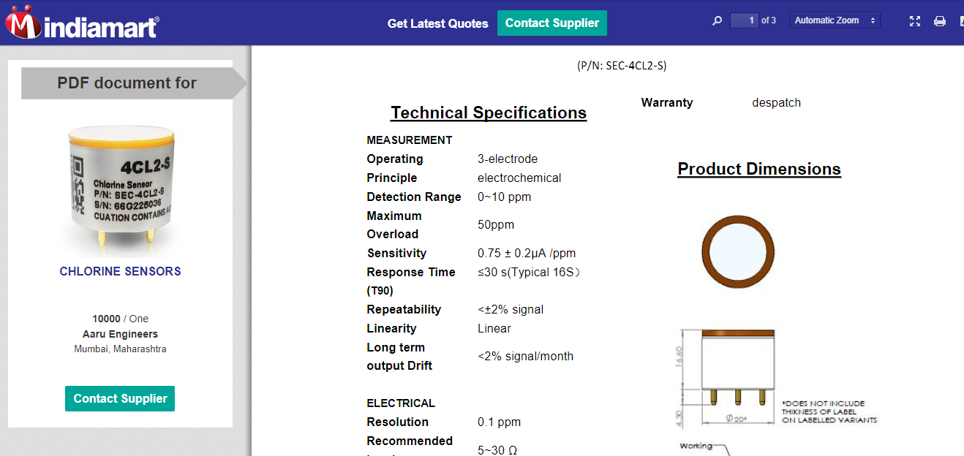

Slide 7
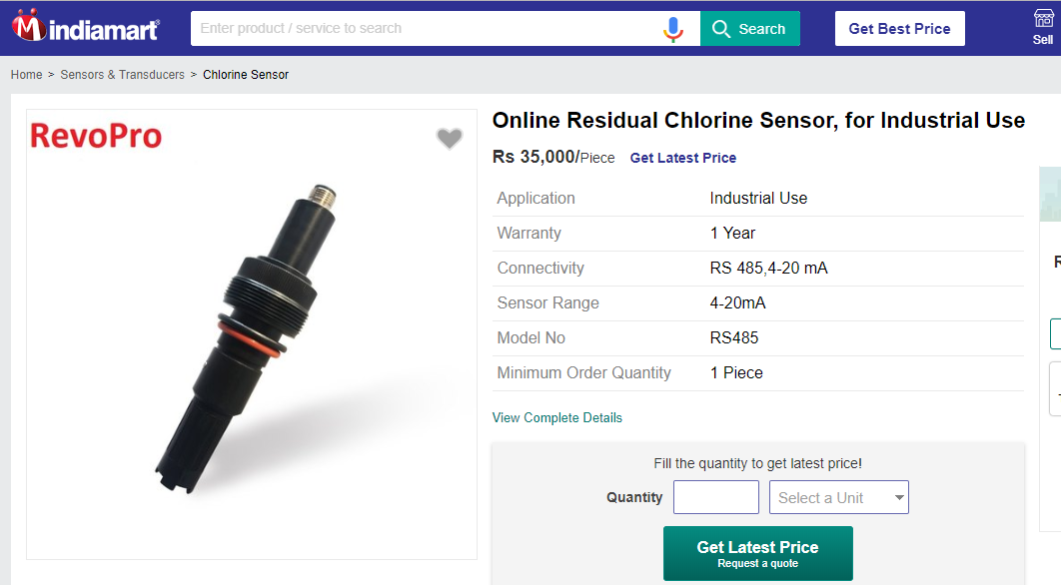

Slide 8
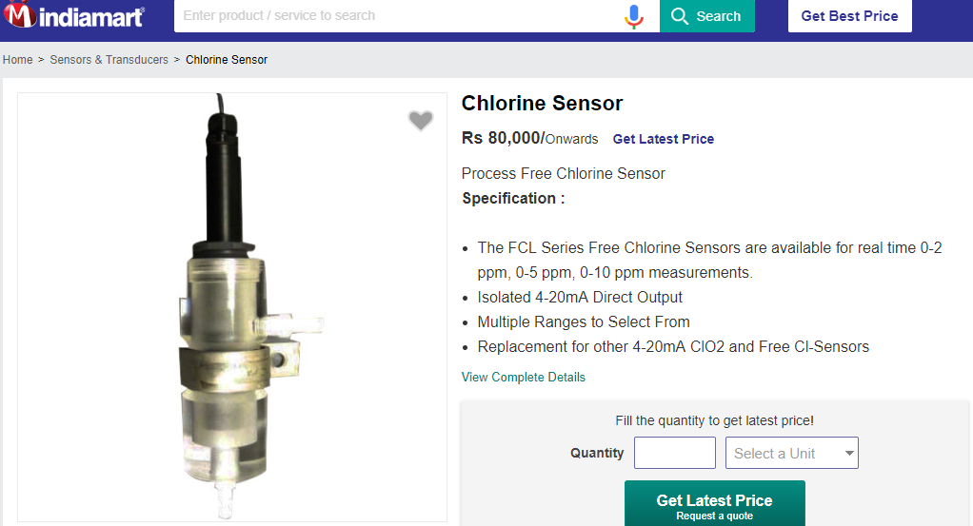

Slide 9
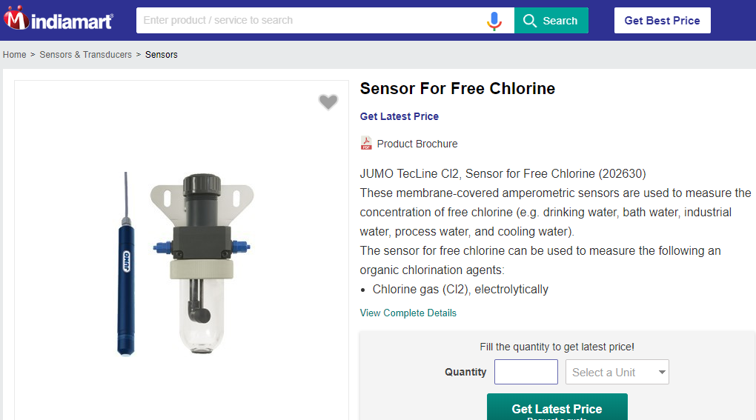
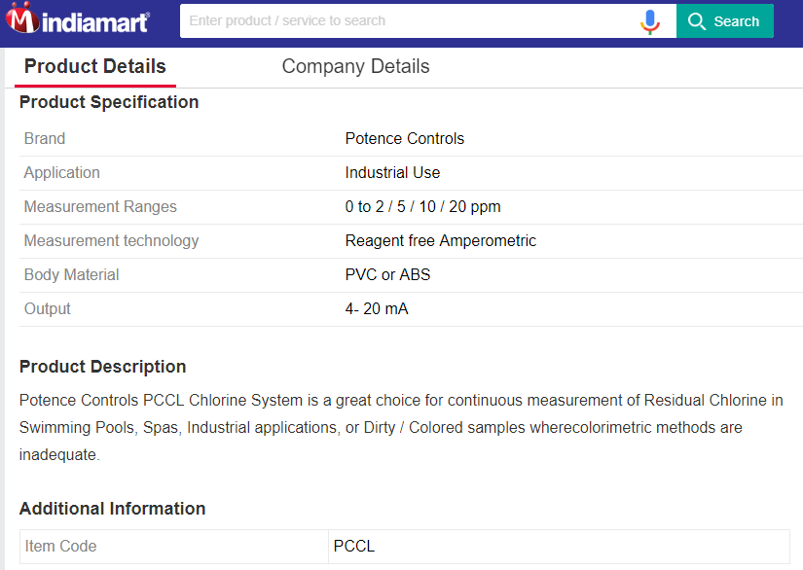

Slide 10
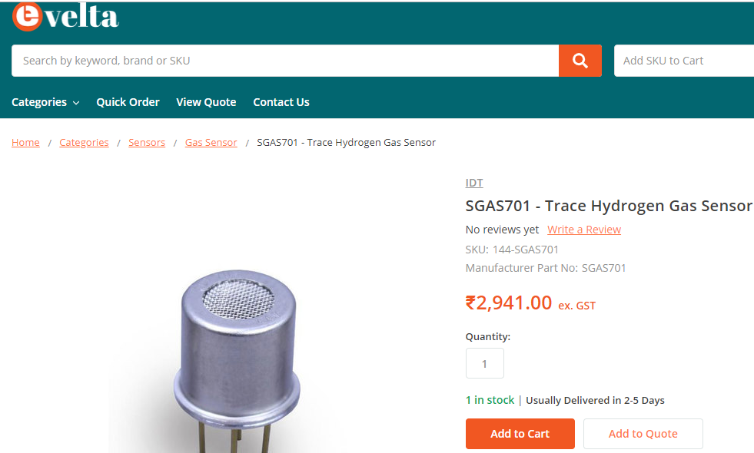
Sensors for hydrogen

Slide 11
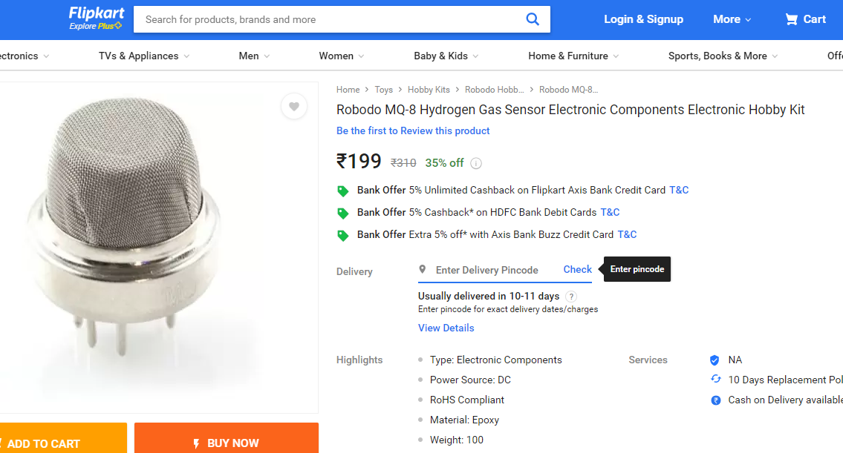

Slide 12
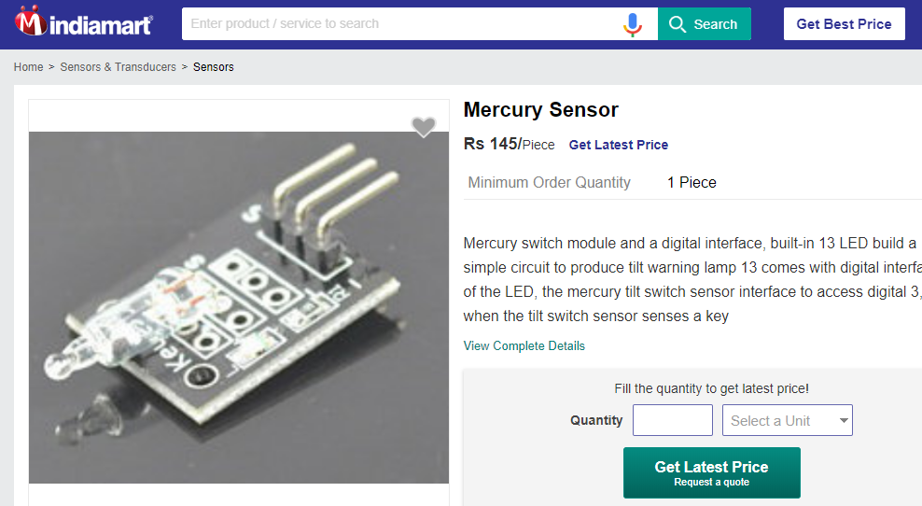
Sensor for mercury

Slide 13


Slide 14
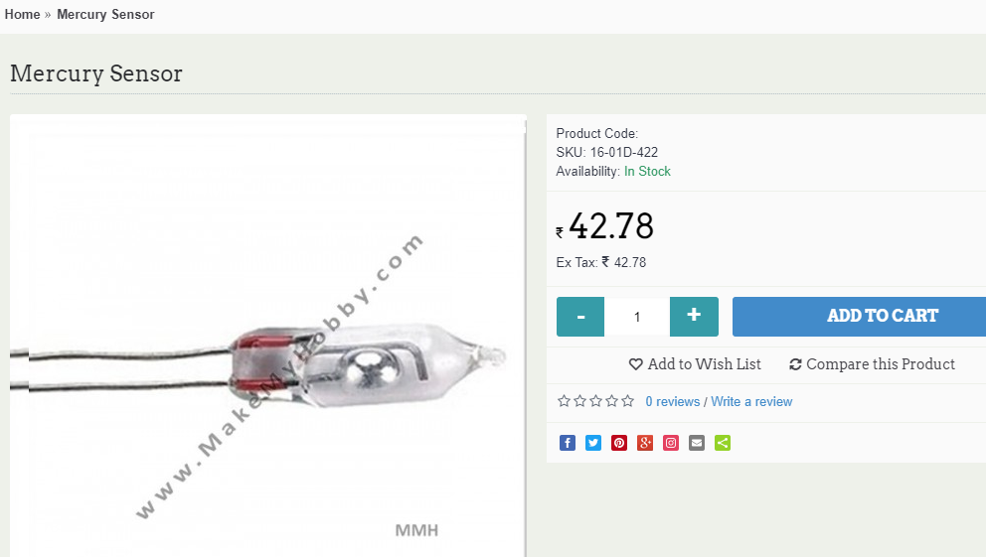

Slide 15
